Slide 1


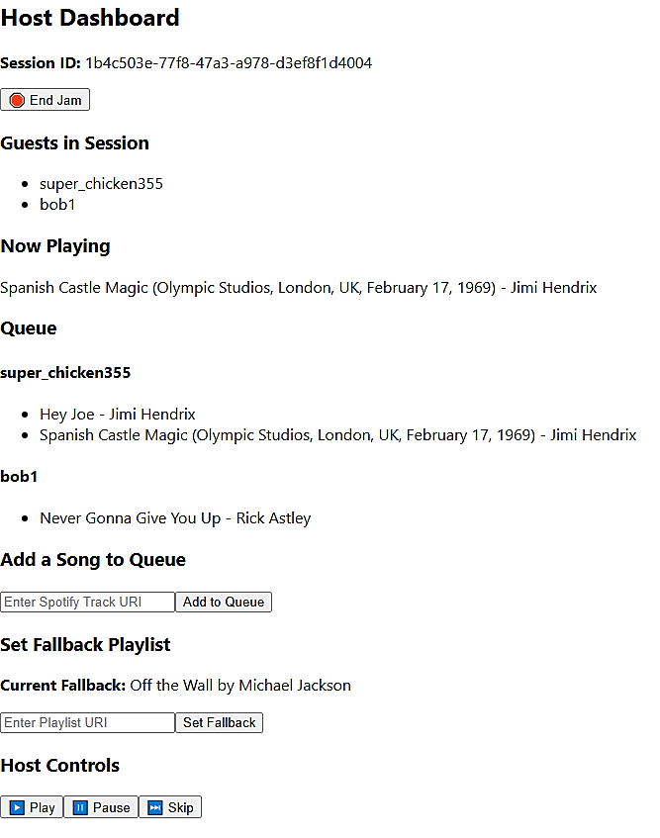




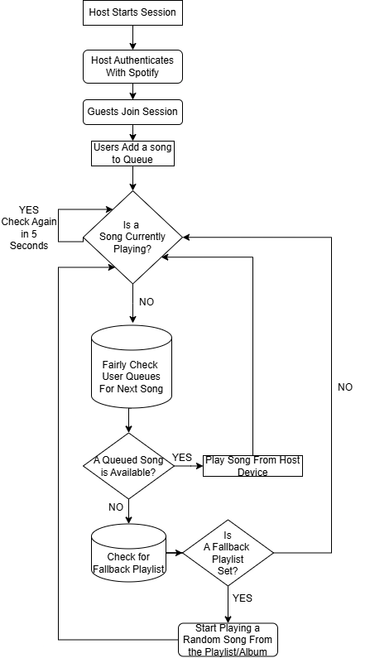
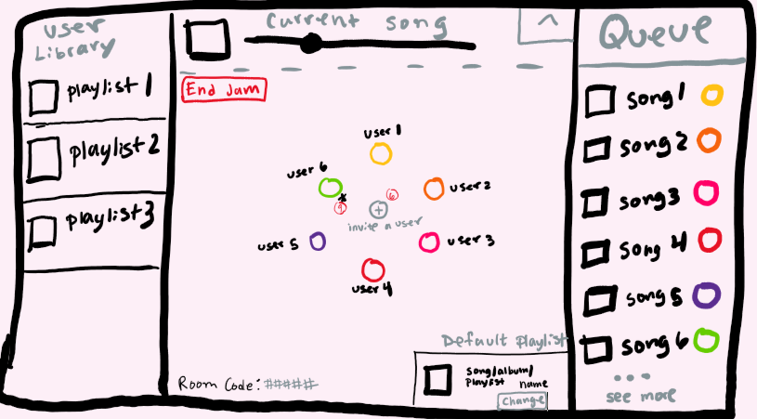
Fair Spotify Jam
Trysten Giorgione
Computer Science
Advisor: Fred Annexstein
PROBLEM
Host Dashboard UI
When listening to songs with a group in a Spotify Jam, the queued songs are played in a “first queued first played” fashion. This makes the queue unfair and makes it possible for users to be over/underrepresented in the Jam session.
USER STORIES
When in a Spotify Jam, I feel like other people queue many songs before I can even queue one.
After an enjoying night hanging out and listening to music with friends, I wish I could easily save a playlist of all the songs we listened to.
SOLUTION
TECH USED
A webapp that improves Spotify’s group listening functionality by implementing fair queue management. Using the
Spotify API, our solution aims to ensure all users in a shared session are equally
represented in the song rotation. This approach will enhance user
satisfaction and encourage a more enjoyable, balanced experience for
group listening.
React
Visual Studio Code
DESIGN FLOW CHART
CHALLENGES
Using Spotify API
Finding work-arounds for when Spotify’s API wasn’t enough (ex. native Jam has no API support)
Managing time on the project with the busyness of being a senior
FUTURE PLANS/GOALS
Develop a smoother UI to increase QoE and QoS for users
If Spotify ever allows for native Jams to be integrated with their API, session functionalities will become easier to manage, but the logic will need updated.
More potential party/fun features (e.x. category game)
ACCOMPLISHMENTS
Hosts can start a session and authenticate with Spotify
Guests can join a session via session ID and add songs to queue
The currently playing song and queues can be seen on host and guest dashboards
The queue algorithm gives every user a fair chance to have a song played every rotation through users
Hosts can save the songs that were played in a session as a playlist
DESIRED HOST UI STYLE DRAFT

